Slide 1
The National Institute of engineering, Mysuru - 570008
Title of the project
Web Application for Co-curriculum nie
Presentation presented by :
Anantha Bharath 4NI20IS017
Mahesh S 4NI20IS058
Yashwanth K S 4NI20IS127
Mohan Kumar Kalmani 4NI20IS064
Minor project presentation under the mentorship of
Ms. Ashwini M

Slide 2
Introduction
This web application can be used both by the students and the management , it facilitates the students who participates in the sports , curricular , and other events like placement talks and activities to preserve their attendance . it can be used by the management to inform related students about the events they can partake, this creates a personalized environment for both the users.
It is Student supportive development just like contineo where students can login and check there status in different sports, also facilitates attendance for their events simultaneously.

Slide 3
Problem statement
Presently we do not have any separate section for the purpose of the cocurriculuar activities in Nie . All the notifications regarding these events are either sent through whatsapp by several members that do not always reach everybody sometimes these notifications are sent via email thar are often ignored
OBJECTIVE
To create a web application where students , faculty, parents and aspirants can look about the co curricular activities held in Nie. This web application also provides the related members of the users to gain information related to their activites and also helps to maintain attendance of the participating students. We aim to bring more transparency in these cultural and co curricular acts between both the users of our web application

Slide 4
Requirements
SOFTWARE
1. VS Code
2. Bootstrap
3. Mongo db
4. React JS and Node JS
5.Mongoose,Express,Nodemon,Postman
HARDWARE
1. Intel Core i5 or any equivalent Processor.
2. 4GB RAM.
3. 1GB ROM.
4. Google Chrome or Equivalent Browser.

Slide 5
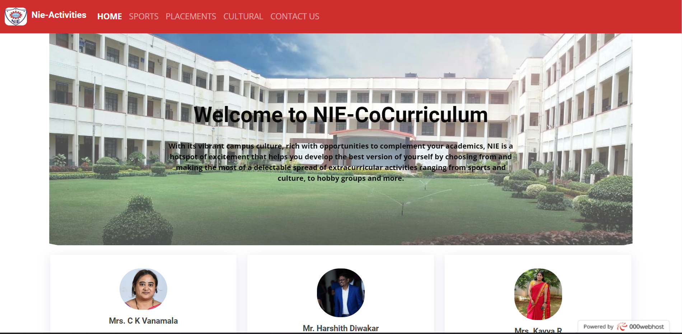
procedure
This web application provides a home page that consists of a various of features that can be used to view information about previous sports and co-curriculum events that have been held lately in the college .
Users can navigate through the website to gain info about these events like sports, placement activities etc.
It provides login page to students in which participating students can fill the attandence
form to maintain their academic attendance.
Here they can fill out forms for participation for events , mange their attendance for the events they are participating and view all their previous participation.

Slide 6
Existing system and its limitations
Presently we do not have any separate section for the purpose of the cocurriculuar activities in Nie . All the notifications regarding these events are either sent through whatsapp by several members that do not always reach everybody sometimes these notifications are sent via email thar are often ignored .
Students who did participate in the events struggle to maintain their academic attendance and are bid to run around the required faculty for their attendance .
Currently the notifications that are sent to are not being reached by majority of the students . The selective few are the ones who are participating and the else are less aware of the events being held.

Slide 7
Proposed system and its advantages
Using this website it provides for all students the platform for attandence and recent sport activities.
It provides secure communication between student and the faculties using the login page. Unauthorized access not possible.
Students have access to view the recent activities of sports and co-curricular activities. It ensures the security of co-curricular activities.
It is like our contineo website. Everyday students can visit this site to get know about what are the recent sport and co-curricular activities.
This platfrom provide more insights to regarging co-curricular activities.All students can visit the site if the username and password is correct.It will go the attandence form if we login through the login page and the students who have participated in sports and co-curricular activites can fill this form and it will go to specified
faculty through the email, whatsapp and the form.They will verify the document that is sent using the attandence form in this way there is a secure communication.It saves the time for both the students and the faculty.

Slide 8
Literature survey
TITLE | AUTHOR | INFEERENCE
A Review on Web based attendance management | Arvind Lal, Chumphlla Bhutia, Bidhan Pradhan, Monisha Limboo | The proposed system is web based which will be fully responsive and the user can use it in their mobiles , tablets and desktops.
Attendance management system using a Mobile device and a Web application | Jun Lio | In this paper attendance management is done by using both mobile based and web based , the architecture uses Monaca application
An Interactive Online Training and Placement System | Nilesh Rathod, Seema Shah, Kavita Shirsat | In this paper an interative web based model is presented for the placement related activities of a college.
Project Management System | Haseena V, Shaheer K | In this paper the project management system based on web application is demonstrated.

Slide 9
Literature survey
TITLE | AUTHOR | INFERANCE
Sports Management platform for colleges | Mrs. Roopalakshmi S | The application is created as two modules admin and user. This paper provides demonstration for sports event management for colleges.
Journal of small business management | Auger Pat | The Impact of interactivity and design sophistication on performance of websites.
Design and Implementaion of Mobile phones based Attendance marking system | Mohammad Ausaf Anwar, Durgaprasa Gangodkar | In this paper , the architecture and design specifications on an android platform are presented.
Computers in human behaviour | Braddy Phillip W, Meade Adam W, Kroustalis Christina M | The effects of organizational familiarity, website usability and website attractiveness on viewers.

Slide 10
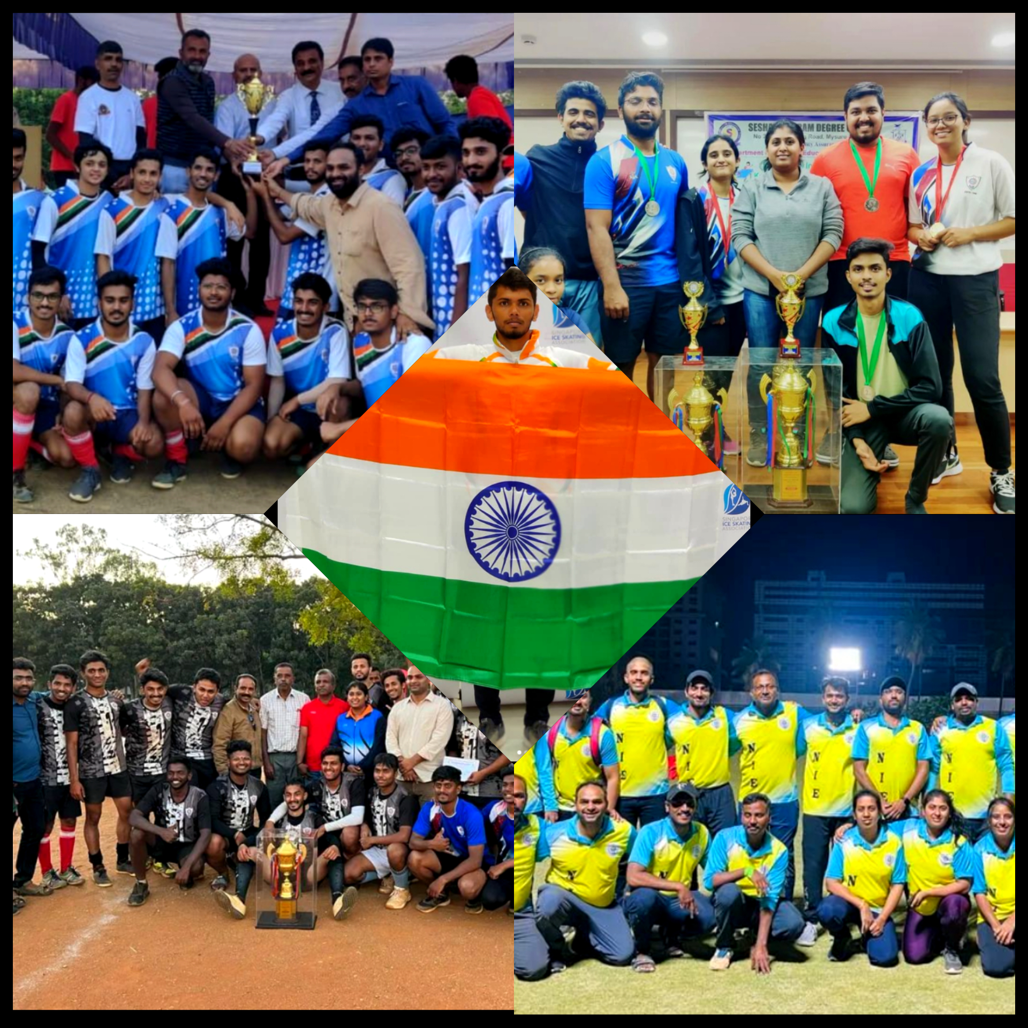
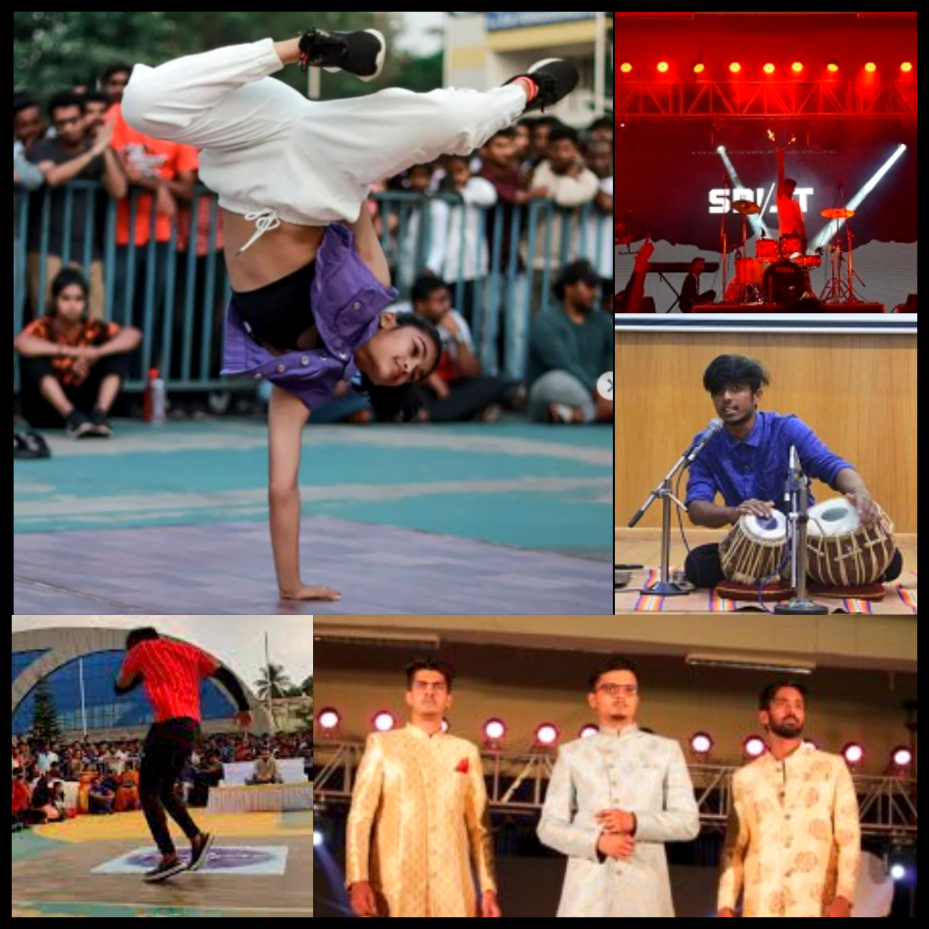
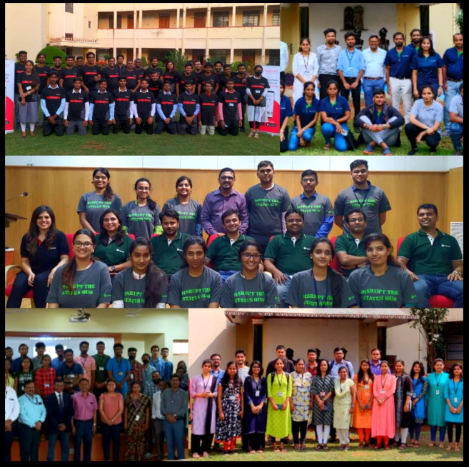
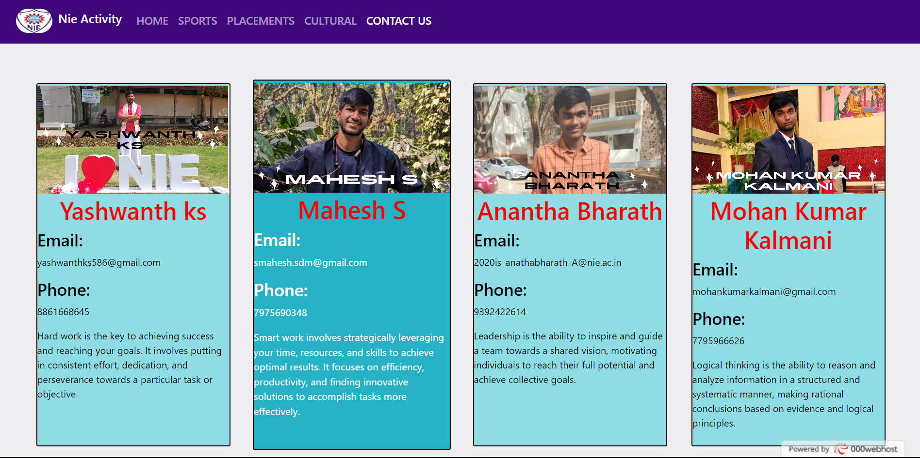

Slide 11
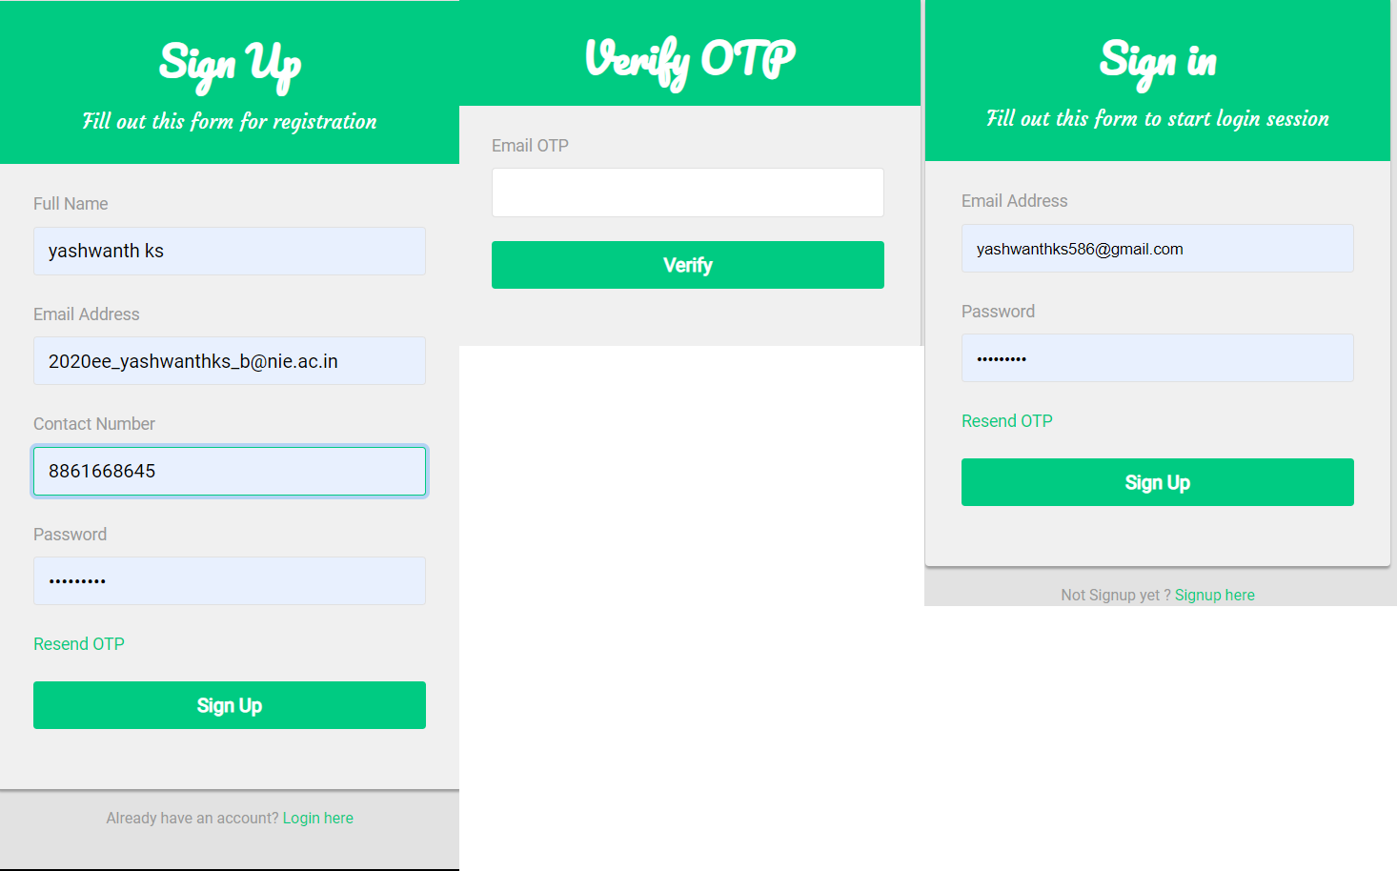
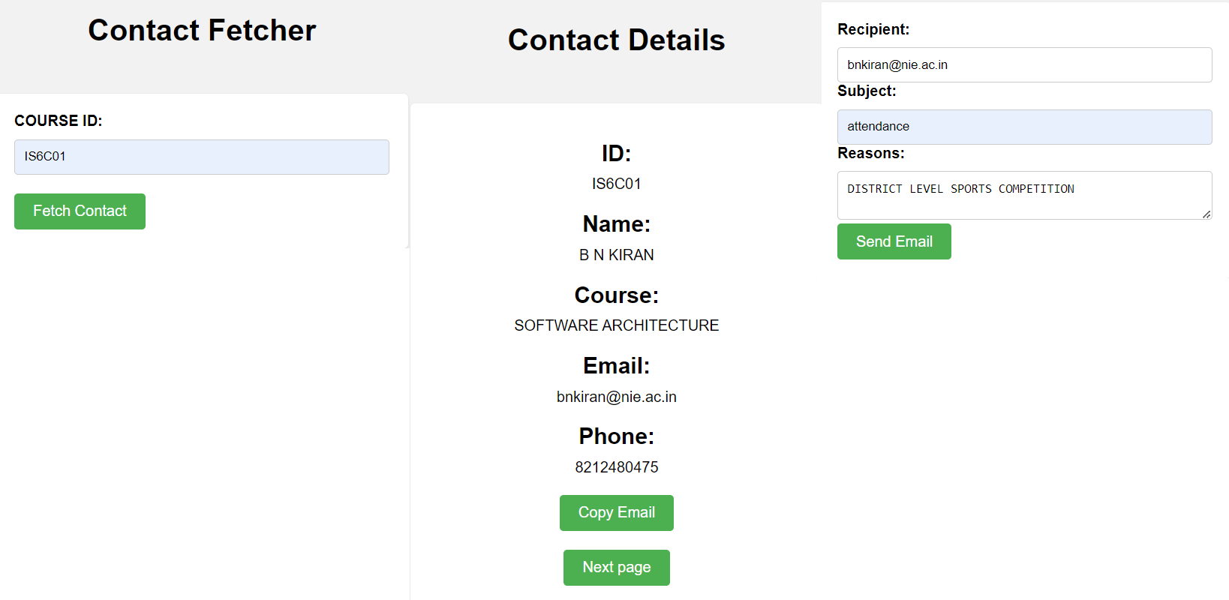

Slide 12
CONCLUSION AND FUTURE ENHANCEMENTS
It allows the students to easily approach respective faculties on their attendance issues due to their extra curricular activities and been a best method to solve the problems faced by the students.
This project provides a best solution for attendance issues and it provides a secure and reliable interface for both students and faculties.
In the future, the platform may add features like advanced search, personalized recommendations, and gamification elements to make it even more engaging.
Enhance the user interface and navigation of the website to make it more intuitive, user-friendly, and visually appealing.

Slide 13
References
Wangwei, lingqiang “Design and Implementation of small and medium Sports Event Management Platform for College”, pp: 379-382, IEEE 2015
Yue Jun, Liang Ying, Ye Yuyi and Long Jifeng“ Research and Design of Application for Sports Information Management Platform Based on B/S architecture”, pp: 375-378, hezhou university 2015
Huang wenhui, Zhang zhen “Innovation of management module of sports event based on knowledge management” IEEE 2011
Mohammad Ausaf Anwar, Durgaprasad Gangodkar, “Design and Implementation of Mobile Phones based Attendance Marking System”, Department of Computer Science Engineering, Graphic Era University, Dehradun, Uttarakhand, India, 201
Mahesh G, Jayahari KR, Kamal Bijlani, “A Smart Phone Integrated Smart Classroom”, Amrita e-Learning Research Lab (AERL) Amrita School of Engineering, Amritapuri, Amrita Vishwa Vidyapeetham, Amrita University, India, 2016
Ekta Chhatar, Heeral Chauhan, Shubham Gokhale, Sompurna Mukherjee, Prof. Nikhil Jha, “Survey on Student Attendance Management System”, S.B. Jain Institute of Technology, Management and Research, Nagpur, 2016

Slide 14
Thank you

